Slide 1
Coarse-to-Fine Decoding for Neural Semantic Parsing
--Longxu Dou

Slide 2
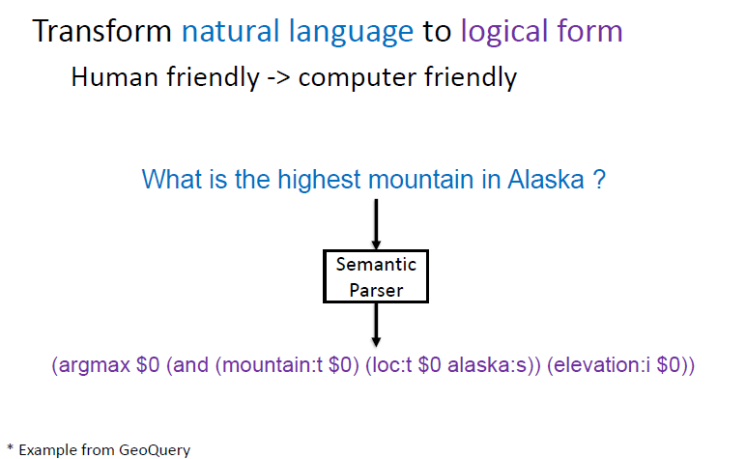
Semantic Parsing

Slide 3
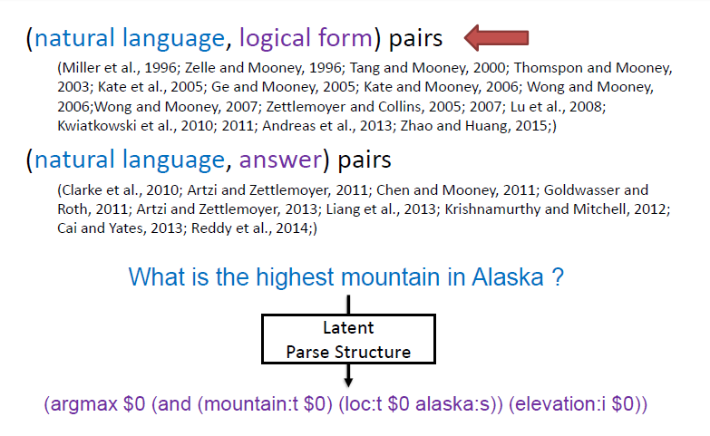
Semantic Parsing -SOTA

Slide 4
Coarse-to-fine Methods
Syntactic Parsing
Use coarse lexical entries or macro grammars to reduce the search space of semantic parsers.
Program Synthesis
Map a sentence into SQL sketches which are completed using program synthesis techniques and iteratively repaired if they are faulty.

Slide 5
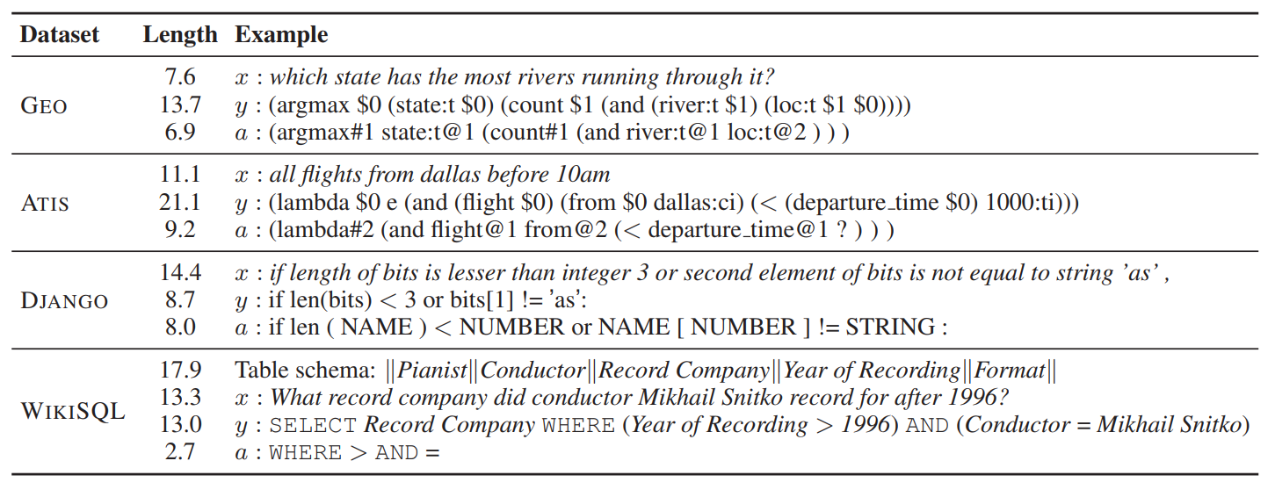
Dataset

Slide 6

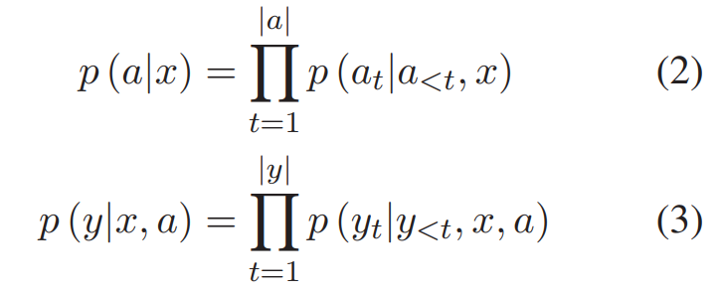
Problem Formulation

Slide 7
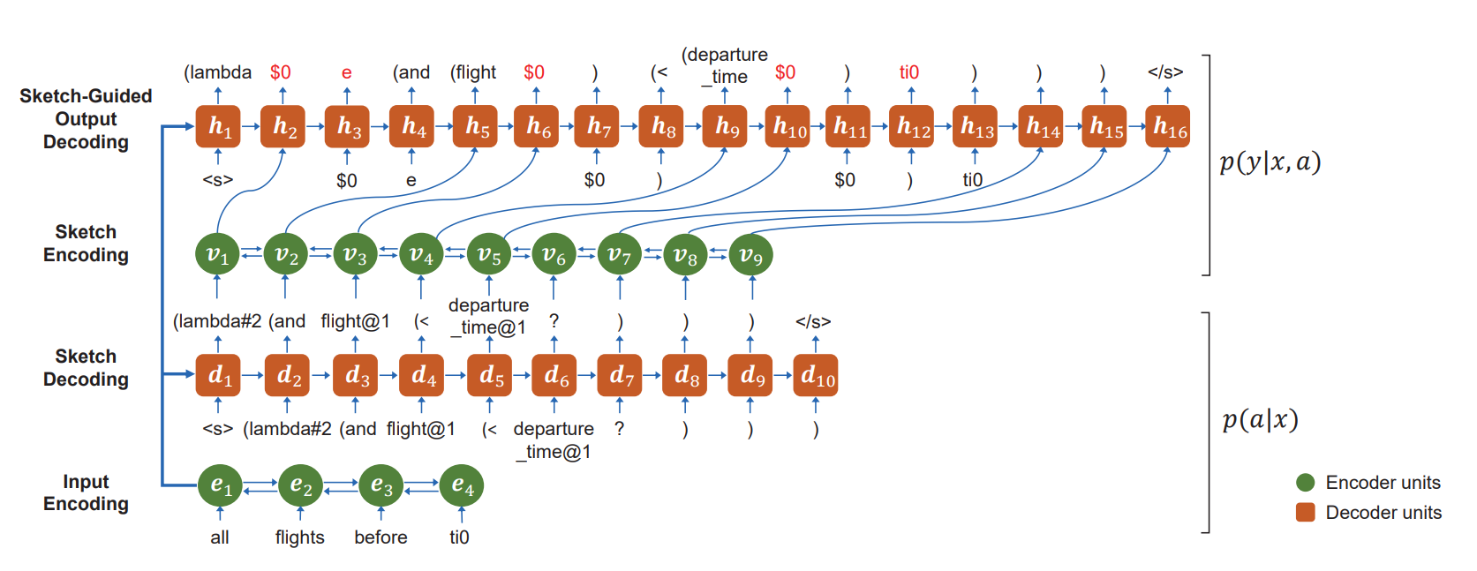
Architecture

Slide 8
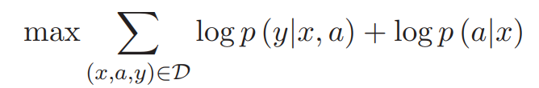



Training and Inference

Slide 9
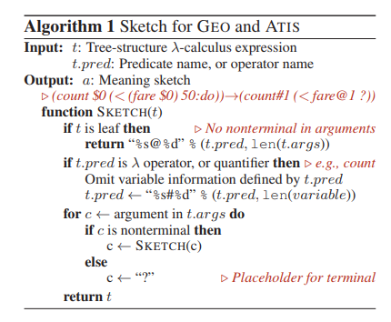
Natural Language to Logical Form

Slide 10

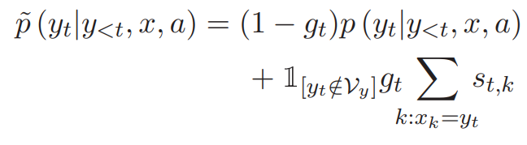
Natural Language to Source Code

Slide 11
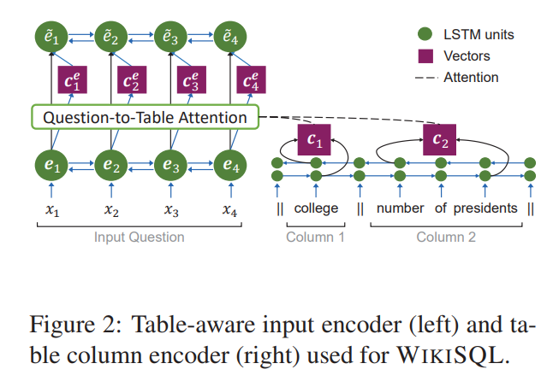



Natural Language to SQL- Table-Aware Input Encode

Slide 12

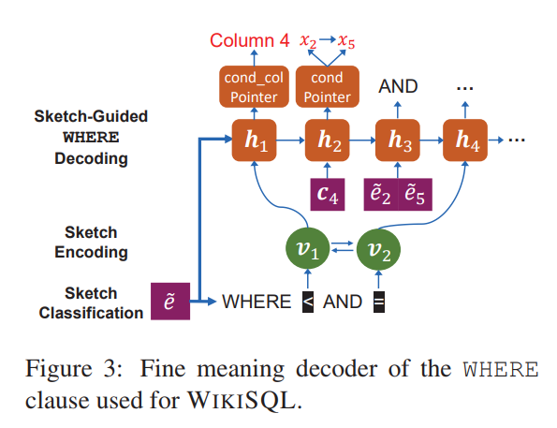

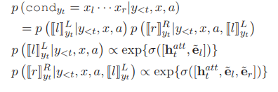
Natural Language to SQL- WHERE Clause

Slide 13
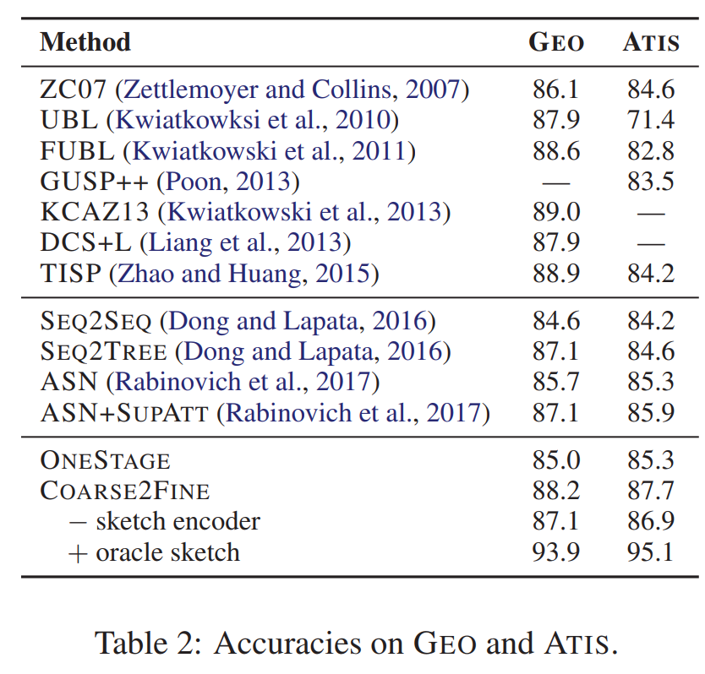
Accuracies on GEO and ATIS.

Slide 14
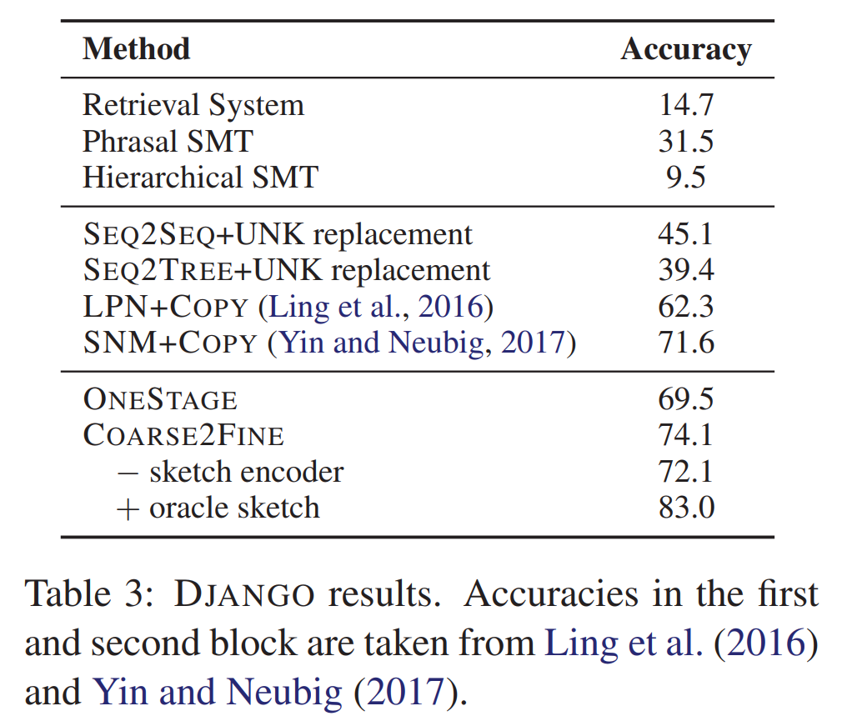
DJANGO results.

Slide 15
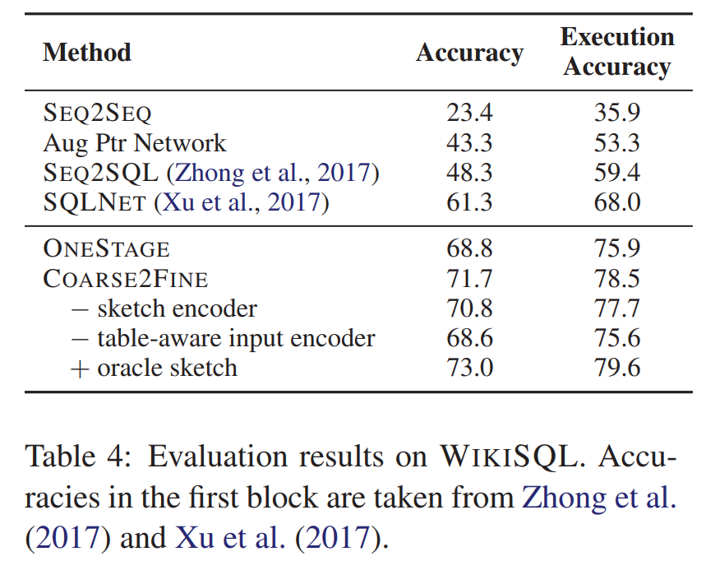
Evaluation results on WIKISQL

Slide 16
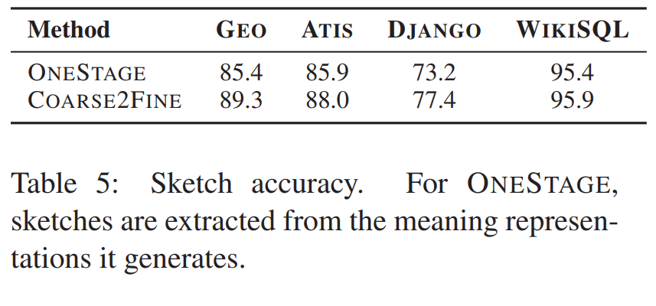
Sketch accuracy

Slide 17
Conclusion
Contribution
Present some methods to obtain training including sketch a.
Ablation study
Future work
Weakly supervised learning: Learn from (question, answer) pairs
Utilize parsing results of questions: CCG / Dependency / AMR

